Slide 1

STOCK PORTFOLIO TRACKER
Project Presentation
By: Manoj Rajkumar Karande
& Prajakta Kate

Slide 2

Introduction
This project is a web-based stock portfolio tracker that helps users manage and analyze their investments.
The idea originated from the need for a user-friendly, automated tool to track stock performance.
It provides a centralized platform for investors to monitor their holdings efficiently.

Slide 3
Problem Statement
Investors struggle to track their stock performance in real-time.
Existing solutions lack personalized insights and are often complex.
Need for an intuitive platform that provides stock data visualization and portfolio analysis.

Slide 4
Solution - Stock Portfolio Tracker
A web application that allows users to add, track, and analyze stocks in their portfolio.
Provides real-time stock prices and visual analytics.
Simplifies investment tracking with an easy-to-use interface.

Slide 5
Technology Stack
Frontend: HTML, CSS, React.js for an interactive UI.
Backend: Node.js and Express.js for server-side logic.
Database: MongoDB for storing user data and stock details.
APIs: Financial stock market APIs for fetching real-time data.

Slide 6
Key Features
Real-time Stock Data: Fetches live stock prices from APIs.
Portfolio Management: Users can add, edit, and remove stocks.
Performance Analysis: Graphs and charts for stock performance.
User Authentication: Secure login and personalized data.
Market Trends: Displays overall stock market trends.

Slide 7
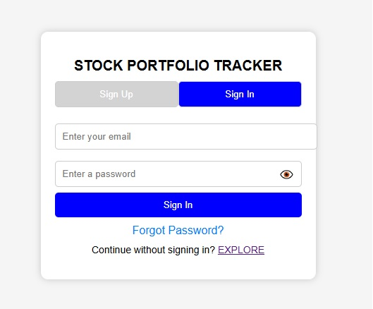
Screenshot
Sign up Page:

Slide 8


Future Enhancements
AI-based Stock Predictions
Using machine learning to suggest stocks.
Real-time Alerts
Notifications for significant stock changes.
Integration with Brokers
Allow buying/selling stocks from the app.
Dark Mode
Improve UI/UX for users.

Slide 9
Conclusion
This stock portfolio tracker provides an intuitive way to manage investments.
Offers real-time stock data, analytics, and portfolio insights.
Future improvements will enhance decision-making for investors.

Slide 10

THANK YOU!

